Slide 1
FINAL PROJECT
TOPIC : DePaul Shopping Centre Project Presentation

Slide 2
Contents
Introduction
Architecture Overview
Features
Technologies Used
Conclusion

Slide 3
Introduction
The DePaul Shopping Centre Project is built by following all the Fundamental principles and Design Patterns.
Moreover, the project gives a user friendly ui where the user can easily interact with the program.
The Fundamental principles followed in the program were SOLID principles. Where all the 5 principles of SOLID principles are being followed by the program.
The Design Patterns like Creational Design Pattern, Structural Design Pattern, and Behavioral Design Pattern are also followed so the pattern of the program is organized.
The project also have testing units like ShoppinCartTest, CatalogTest, PaymentProcessortest.

Slide 4
Architectural View:
Overview of the Project’s UML diagram

Slide 5
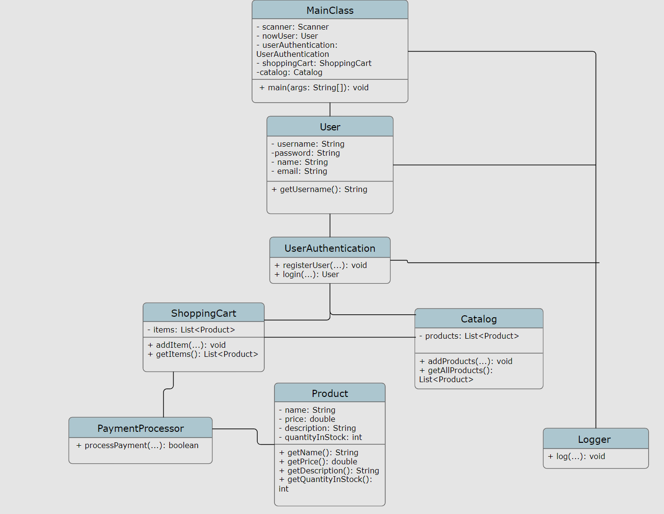

Slide 6
Features
Register as a new user
Login as an existing user
View all products
Add a product to cart
View cart
Place an order
Exit the shopping center

Slide 7
User Registration:
Allow new users to register by providing their username, password, name, and email.
Ensure validation of user input to maintain data integrity and security.
User Login:
Enable existing users to log in using their username and password.
Implement authentication mechanisms to verify user credentials securely.
Product Browsing:
Provide a catalog of available products in the shopping center.
Allow users to view product details such as name, price, description, and quantity in stock.

Slide 8
Adding Products to Cart:
Allow logged-in users to add products to their shopping cart.
Implement functionality to update the quantity of items in the cart.
Viewing Cart:
Enable users to view the contents of their shopping cart.
Display the list of items in the cart along with their prices and quantities.
Placing Orders:
Provide functionality for users to place orders for the items in their cart.
Implement order processing mechanisms to handle payment and confirmation.

Slide 9
Exit Shopping Centre:
Allow users to exit the shopping center and terminate their session.
Ensure proper cleanup of resources and data upon exit.
User Feedback:
Consider incorporating features for users to provide feedback or ratings on products and their shopping experience.
Implement mechanisms to collect and analyze user feedback for continuous improvement.
Error Handling:
Implement robust error handling mechanisms to handle exceptions and edge cases gracefully.
Provide informative error messages to guide users in case of invalid input or system errors.

Slide 10
Accessibility and Usability:
Ensure that the system is accessible and user-friendly for users of all abilities.
Consider usability testing to identify and address any usability issues.
These points should provide a comprehensive overview of the features offered by the Shopping Centre Management System.

Slide 11
Technologies Used
The programming language used for developing the system is Java programming language.
The integrated development environment used for this is Eclipse however, it can run in other IDEs like IntelliJ.
For storing and managing the data DBMS used in this project was MySQL.
The version control system used for managing source code is Git.
Testing framework utilized for automated testing is Junit.

Slide 12
Conclusion
Therefore, I conclude that this project gives an overview of DePaul Shopping Centre. In here, a user can browse variety of products in the catalog also prices are differentiated according to their variance. A simple GUI is also created for a user-friendly experience.

Slide 13
Thank you
MOVVA HARI KOMAL DASARATH CHOWDARY
Student id : 2187390

